Slide 1
Recent Trends of Software Engineering
- John Sylvester

Slide 2
Topics :
Traditional method of software development
Agile
Scrum
Kanban
Scrumban

Slide 3
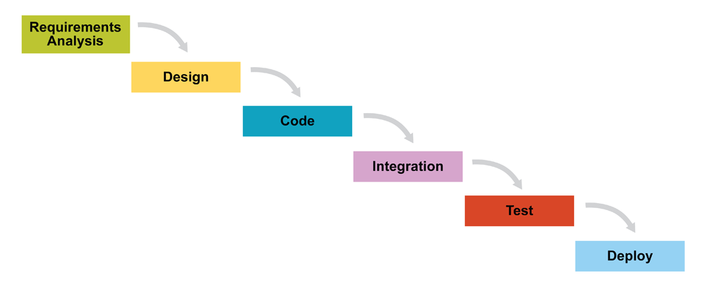
Software : How it is developed ? - Traditional way
Old methodology - Waterfall model

Slide 4
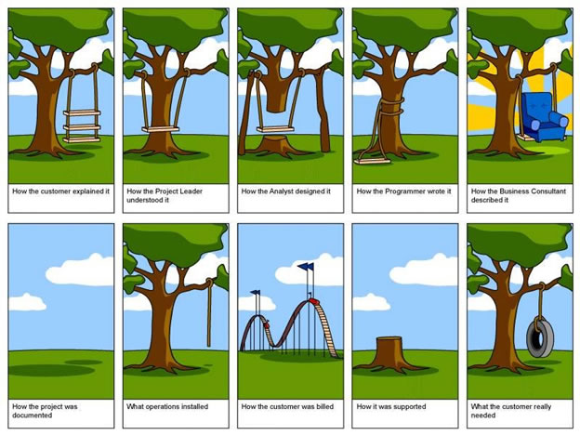
Software Development : Drawbacks due to traditional model

Slide 5
Drawbacks in Traditional Software Development method :
Lack of :
Team Engagement
Transparency
Frequent Delivery
Predictability
Change
Business Focus
Customer Focus
Quality
Traditional “waterfall” development depends on a perfect understanding of the product requirements at the outset and minimal errors executing each phase.

Slide 6
Agile : The Game Changer
Agile blends all development activities into each iteration, adapting to discovered realities at fixed intervals.

Slide 7
Software : How it is developed ?
Approach : Agile
Agile is a group of software development methods in which requirements and solutions evolve through collaboration between self-organizing , cross-functional teams.

Slide 8
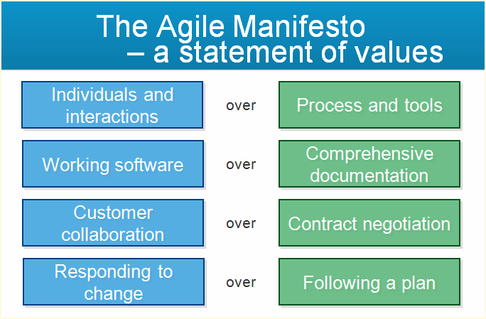

Slide 9
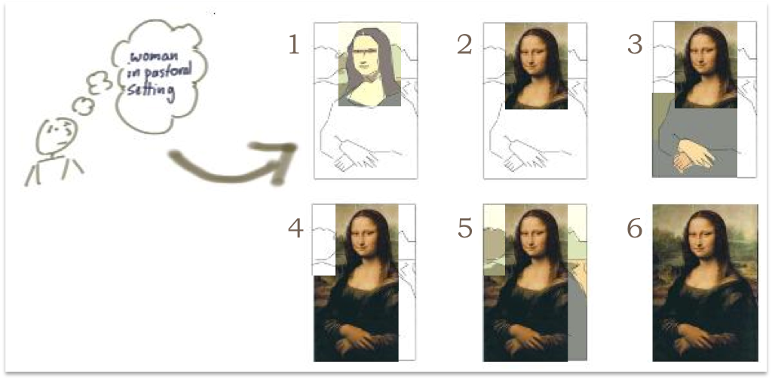
Software Development : Agile

Slide 10
Software : How it is developed using Agile?
Approach : Agile Principles
Early and continuous delivery
Changing requirements
Deliver frequently
Work together daily
Trust the team
Face to face conversation
Working software
Technical excellence, good design
Team reflects and then tunes.
Source : http://agilemanifesto.org/principles.html

Slide 11
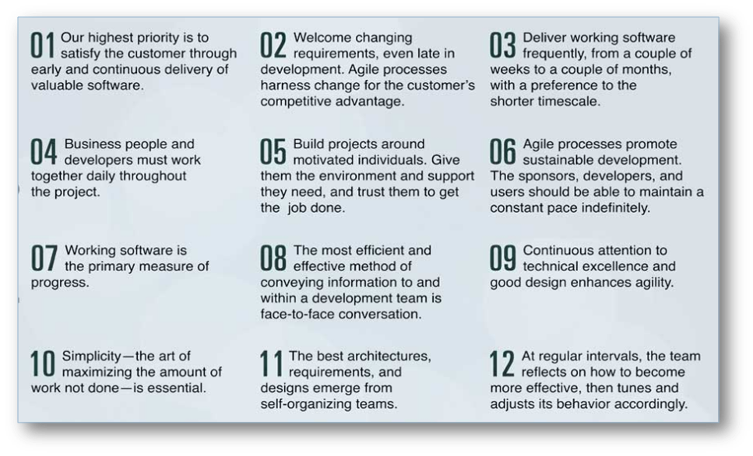
Agile Principles

Slide 12
Software : How it is developed ?
Approach : Agile Advantages
Team Engagement
Transparency
Frequent Delivery
Predictability
Allows for change
Business Focus
Customer Focus
High Quality

Slide 13
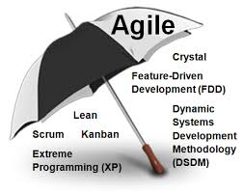
Software : How it is developed ?
Agile Umbrella :
Scrum
Kanban
SAFe
XP

Slide 14
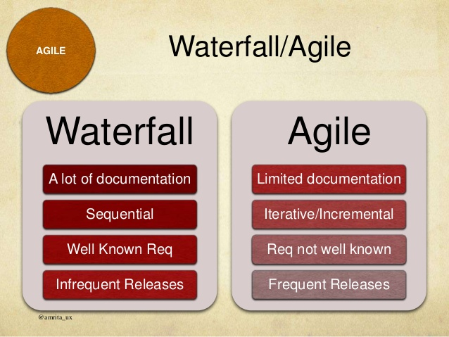

Slide 15
Scrum

Slide 16
Software : How it is developed ?
Agile : Scrum
Best when small ( 7 +/- 2)
Dedicated and persistent
Cross functional
Collaborative

Slide 17
Lets watch a Video :
The hare and the tortoise Story
https://www.youtube.com/watch?v=GXTeFa43730

Slide 18
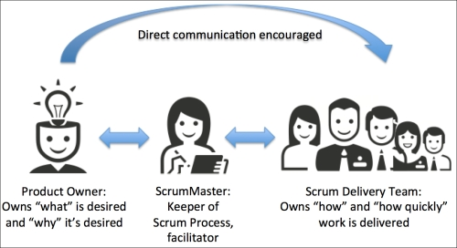
Software : How it is developed ?
Agile : Scrum : Key Roles
Scrum Master
Product Owner
Team Member

Slide 19
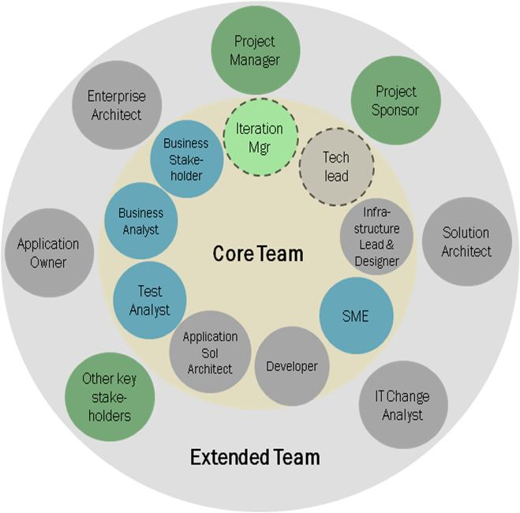
A
G
I
L
E
T
E
A
M

Slide 20
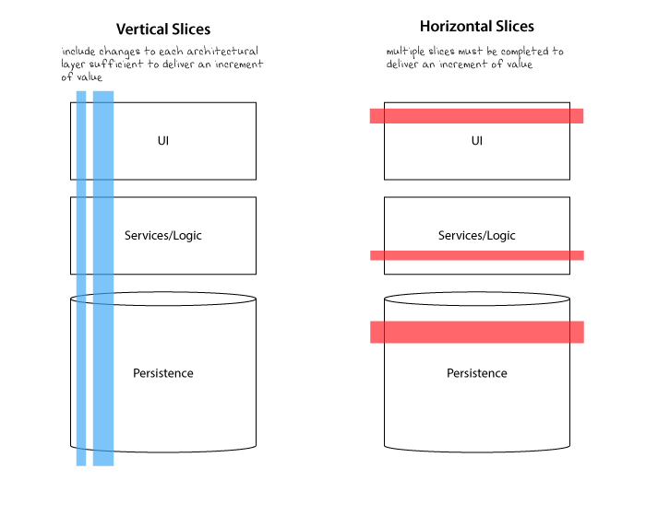
A
G
I
L
E
D
E
L
I
V
E
R
Y

Slide 21
Software : How it is developed ?
Agile : Scrum
EPIC
Feature
User Story
Task
Task
Task
Task

Slide 22
Software : How it is developed ?
Estimation :
Using Story points
Eg :
Fibonacci series
1 2 3 5 8 13
b) Shirt Sizes
XS , S , M , L , XL
c) Cricket scores
1, 2, 4 ,6
User Story
Task
Task
Task
Task
User Story :
User Story should be short and should be in the following format :
As a <Role> , I need < Request> , So that <why?>

Slide 23
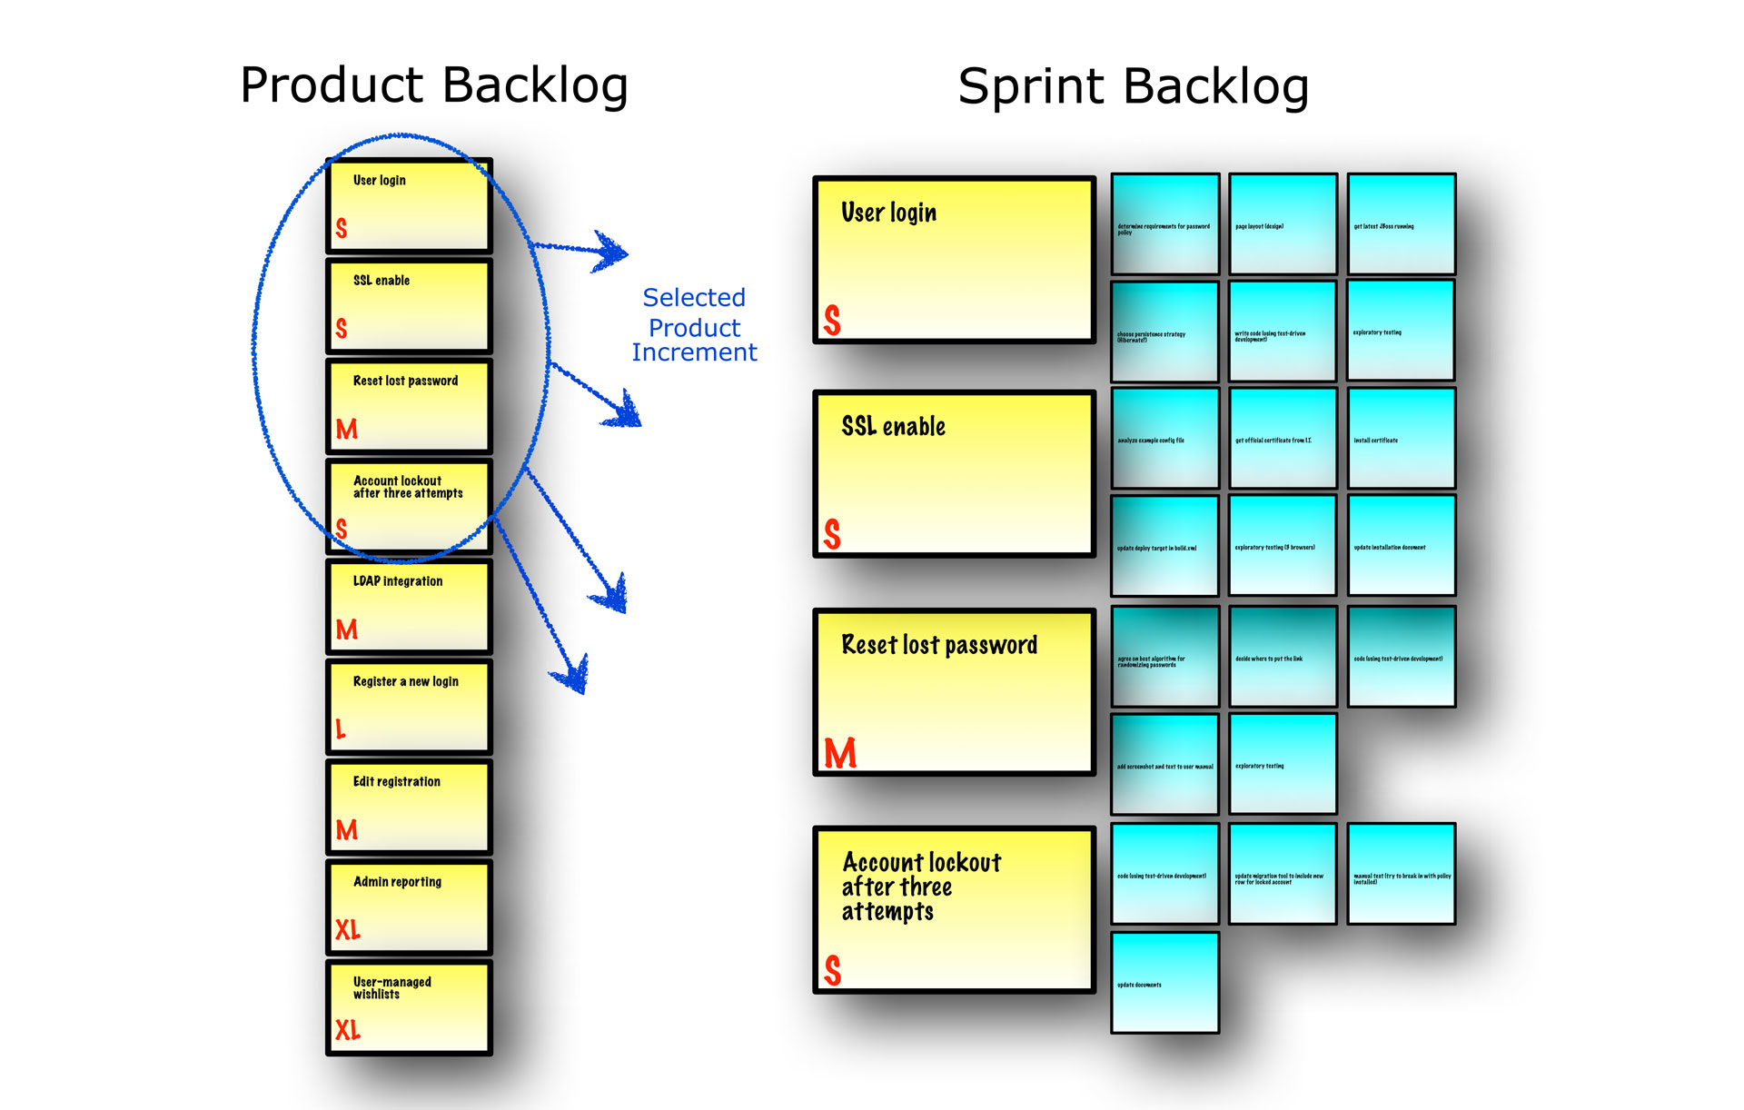

Slide 24
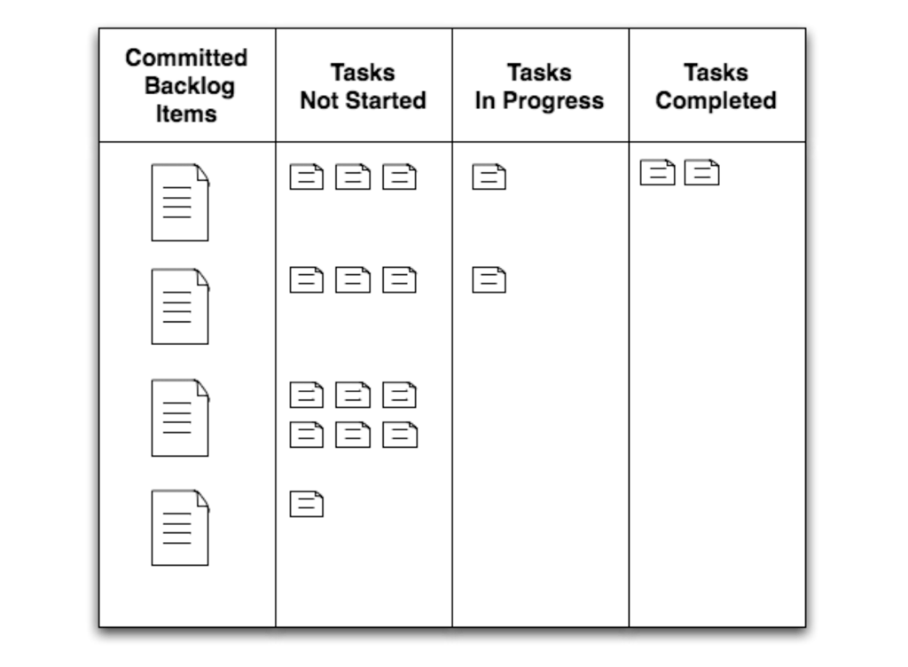

Slide 25
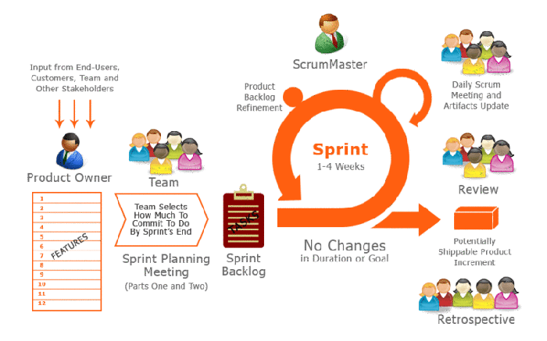
Software : How it is developed ?

Slide 26
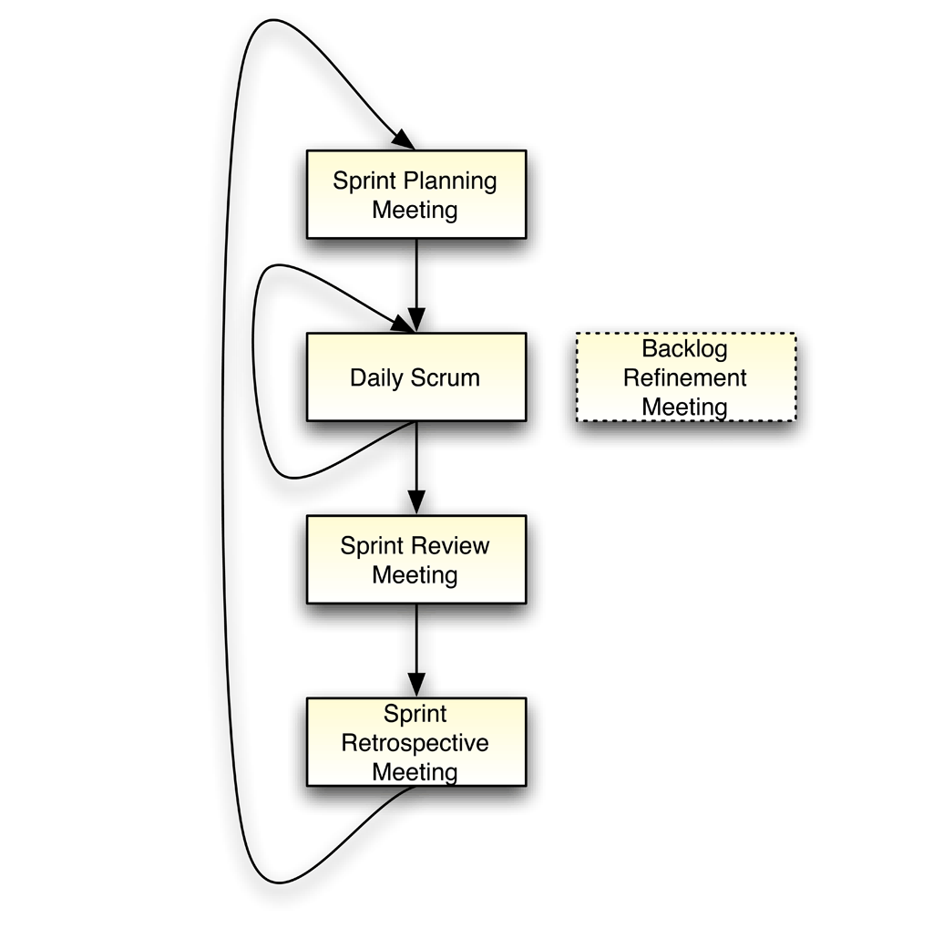
Events :
Sprint Planning
Daily Scrum
Sprint Review
Sprint Retrospective

Slide 27
Kanban

Slide 28
Start with what you do now
Agree to pursue incremental, evolutionary change
Respect the current process, roles, responsibilities & titles
Kanban :
Foundational principles :
Core Principles :
1. Visualize the workflow
2. Limit WIP
3. Manage Flow
4. Make Process Policies Explicit
5. Improve Collaboratively (using models & the scientific method)

Slide 29
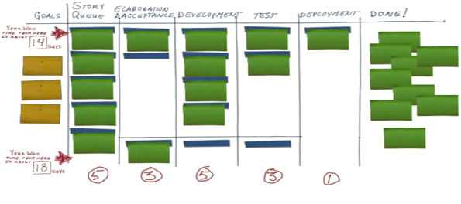
Kanban Board:

Slide 30
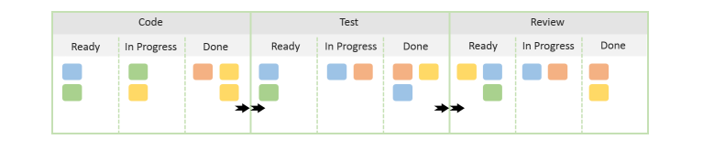
Kanban Board:

Slide 31
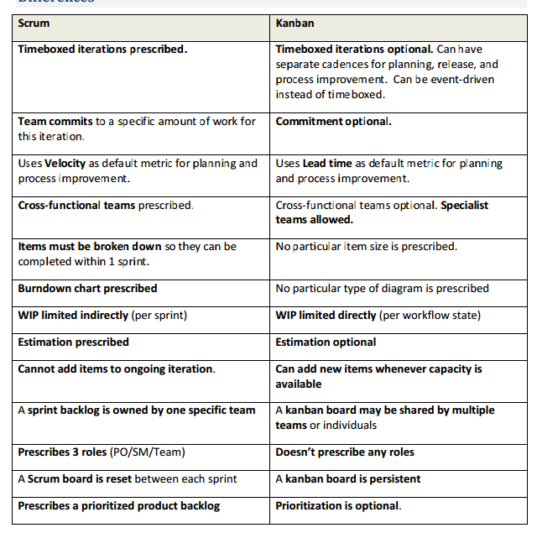

Slide 32
Scrum + Kanban=
Scrumban

Slide 33
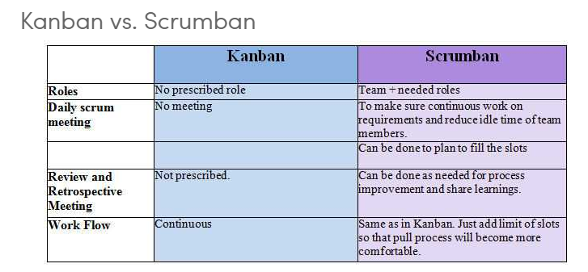

Slide 34
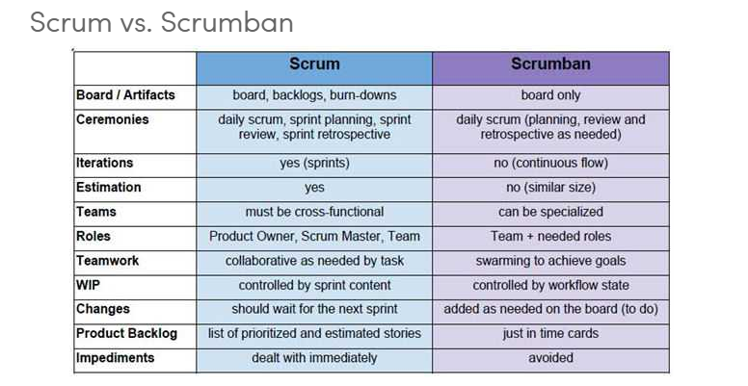

Slide 35
References :
http://scrumreferencecard.com/
Story of Turtle and Rabbit (new version ) - https://www.youtube.com/watch?v=GXTeFa43730
http://www.djaa.com/principles-kanban-method-0
https://www.agilealliance.org/what-is-scrumban/

Slide 36
Thank you

